Slide 1
API Gateway Security Management

Slide 2
Integration & Security Matrix
Security Matrix for Integration
Integration Matrix
Type and classification of data
Is Data shared by several downstream applications?
Type of Integration flow (cloud vs. on-prem)
Method - DBMS, Email, SFTP, REST API, SOAP, EDI, etc.
WHO – BE/Business/IT Solution Lead/PM
WHEN - To complete during demand assessment
Output – Integration Solution Decision
Does data include PII, SPI, HCI?
Is data traveling outside of Enterprise?
Reusable? ( Experience (p2p), Process, System)
Streaming, Caching, Transformation?
Supported Authentication Methods
What Integrations are supported by the application
Direct vs. Middleware
Encryption Type (Field vs. Record vs. Transport)

Slide 3
API Gateway Security Architecture
Enterprise Security Components
Transport
TLS 1.2
Mutual SSL
IP Whitelisting
Identity Access Management
JWT and Oauth for API Authentication
Security policy and compliance
User Level
SAML for User Authentication
Custom API Authorize using metadata
API Keys for App level Authorization
Oauth with PKCE for mobile apps
DDoS
Security logging
Message Level
HMAC for Data Integrity
Data Encryption
Field level Masking for sensitive data
JSON /XML attack Protection
Key Management System
Traffic Level
Quota Management
Spike Arrest for Traffic burst
Circuit Breaker
Developer Level
IAM based login
Role Based Access Control
API catalog access for Public , Internal and Private categorization

Slide 4
API Security Top Concerns
Mitigation or Best Practices for API security Implementation
Issues/Concerns
Broken Object Level Authorization
Broken User Authentication
Excessive Data Exposure
Lack of Resources & Rate Limiting
Broken Function level Authorization
Mass Assignment
Security Misconfiguration
Injection
Improper Assets Management
Insufficient Logging & Monitoring
Security Testing Incorporated in DevOps Process
Implement DDoS or WAF on top of API Gateway
Implement Proof-of –Possession and PKCE for Oauth with Authorization flow
Perform PACT and Semantics Testing for APIs
Implement API Gateway XML and JSON Injection Global Threat Policy
Don’t store API key secret on Mobile or SPA Apps
Implement Global Rate Limiting Policies
Remove Password and Implicit Grant types implementation
Continuous Monitoring of Security Aspects and appropriate alert setup for early detection
For Data sensitive transaction, can implement Push RAR

Slide 5
API Implementation Security
Quota Management. | Quota management for any API can be done either from policy level or define the quota at API method level.
API Alerting | Alerts will be generated and to handle specific incident like management events or security violation and send email to certain email group. If the Security Operation Center (SOC) interface is available API Gateway will send error details to SOC.
Global Security policy | Global Security policy will perform following activities. Throttling will be used in API Manager Level. Check the allowed Message Size. Check the allowed Content Type. Check any threatening content in the message (also in header & query parameter) The complexity of the XML is checked in terms of number of nodes, attributes per node, and number of child nodes per node. If any of these filters return an error, the corresponding error handler is called. The error handler is implemented as a policy that sets the value of the error code and message for this error, and then re-throws the exception so that the global fault handler catches it and sends the email notification.
Using anti-virus security (optional) | Scans incoming HTTPs requests with Anti-virus jars and their attachments for viruses and exploits. For example, if a virus is detected, the API Gateway can reject the entire message and return a fault to the client. The virus definition files should be regularly updated.

Slide 6
API Implementation Security
Certificate based security | Whenever API Gateway receives an X.509 certificate, either as part of the SSL handshake or as part of the XML message itself, API Gateway validates whether the certificate is valid or not These can be done by three ways Online Certificate Status Protocol (OCSP) Certificate Revocation List (CRL) XML Key Management Services (XKMS)
Message Level Security | Content-based Filtering: Security is enabled based the content of the client message like JSON schema validation, HTTP Header validation query string validation, timestamp validation and other message body validations. Data Encryption: Encrypt data using JWT decrypt/encrypt, XML decrypt/encrypt, SMIME decrypt/encrypt to ensure integrity of the message. Additionally, framework such as HMAC can be utilized for Data integrity Ensure to follow AES-128,256 and SHA-256,382 algorithm for encryption

Slide 7
API Platform Security
API Firewall | The recommended strategy for the solution is that utilize current Load balancer based firewall implementation. Incase, API Gateway/SaaS Platform can provide API firewalling capabilities by configuring Apache Mod Security or other means, then below are the key security coverages should be considered:- Virtual Patching IP Reputation Web-based Malware Detection Webshell/Backdoor Detection Botnet Attack Detection HTTP Denial of Service (DoS) Attack Detection Anti-Virus Scanning of File Attachments
Inbound and Outbound SSL | Only https interface will be used as interfaces. No http interface will be allowed. For sensitive interfaces mutual SSL connection will be used for the inbound communication.
RBAC model | Use Role-Based Access Control (RBAC) to restrict access to authorized users based on their assigned roles in a domain. Permissions to perform specific system operations are assigned to specific roles, and system users are granted permission to perform specific operations only through their assigned roles. This simplifies system administration because users do not need to be assigned permissions directly, but instead acquire them through their assigned roles. Any user Authentication to API Gateway or API Manager will use active directory.

Slide 8
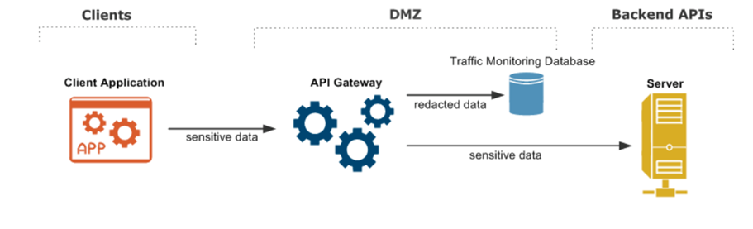
API Platform Security
Sensitive Data Redaction | Sensitive data will be redacted at the API gateway layer, the specific content to redact should be controlled by configuration policies and system should have ability to perform global level redaction for all APIs . API gateway trace and traffic monitoring database sensitive content won’t be present Sensitive content across a range of message protocols and content types such as HTTP, JSON, XML, HTML form, and plain text will be redacted. During the transaction processing, for each traffic monitoring stream, a chain of redactors can be created for redacting the received and sent data. Each redactor removes any sensitive data that it finds and passes the data for the next redactor for processing. The redacted content is then written to the traffic monitoring database

Slide 9
API Gateway Security vs Traditional layers

Slide 10
Using ESB without APIGEE – Security Perspective
Security Feature | APIGEE | ESB
TLS 1.2 | √ | √
Mutual SSL | √ | √
IP whitelisting | √ | √
SAML Token Support | √ | X
API Keys for App level Authorization | √ | X
Token based Authentication ( Oauth , JWT) | √ | X
Basic Authentication | √ | √
Data Encryption | √ | √
Field Level Masking | √ | √
HMAC for Data Integrity | √ | √
JSON and XML Threat Attack | √ | X
Quota Management | √ | X
Spike Arrest | √ | X
Selective security mechanism for different methods of an API | √ | X
APIGEE provides additional security specifically from API access, traffic, token based authentication, granular security patterns for an API and App based Authorization/Access control to APIs
APIGEE provides IP whitelisting for specific APIs as well thus provides more flexibility to apply whitelisting at individual APIs
APIGEE can also facilitate the security token from various API Providers such as Salesforce, Veeva or 3rd Party APIs
APIGEE additional provides API analytics around security dimension which can further used for analysis

Slide 11

Outbound API access ( APIGEE vs non-APIGEE)
Source system
Source system
Source system - 3rd party hosted APIs like World bank, clinical trials APIs or Enterprise hosted APIs like Veeva Vault APIs
Source Hosted : cloud
Target System : On-prem or cloud
API
API
Provides following benefits
Reusability – High reusability for Consuming application where upfront development cost to establish integration with 3rd party APIs or Enterprise APIs are available/performed by API Gateway
Management of APIs - manages who access APIs, API analytics, Traffic management on those APIs from Gateway. Can help in throttle traffic for paid subscriptions like BMI APIs
Standardization - Access API in standardized way , irrespective of Source system security method
Abstraction – breaking up point-to-point brittle integrations and provide abstraction which ensures Consuming system impact on changes from source system are minimal
Catalog - Centralized catalog to provide information on all the APIs available for consumption.
Increases identification of APIs
APIGEE - API Gateway
Consuming or Target system

Slide 12
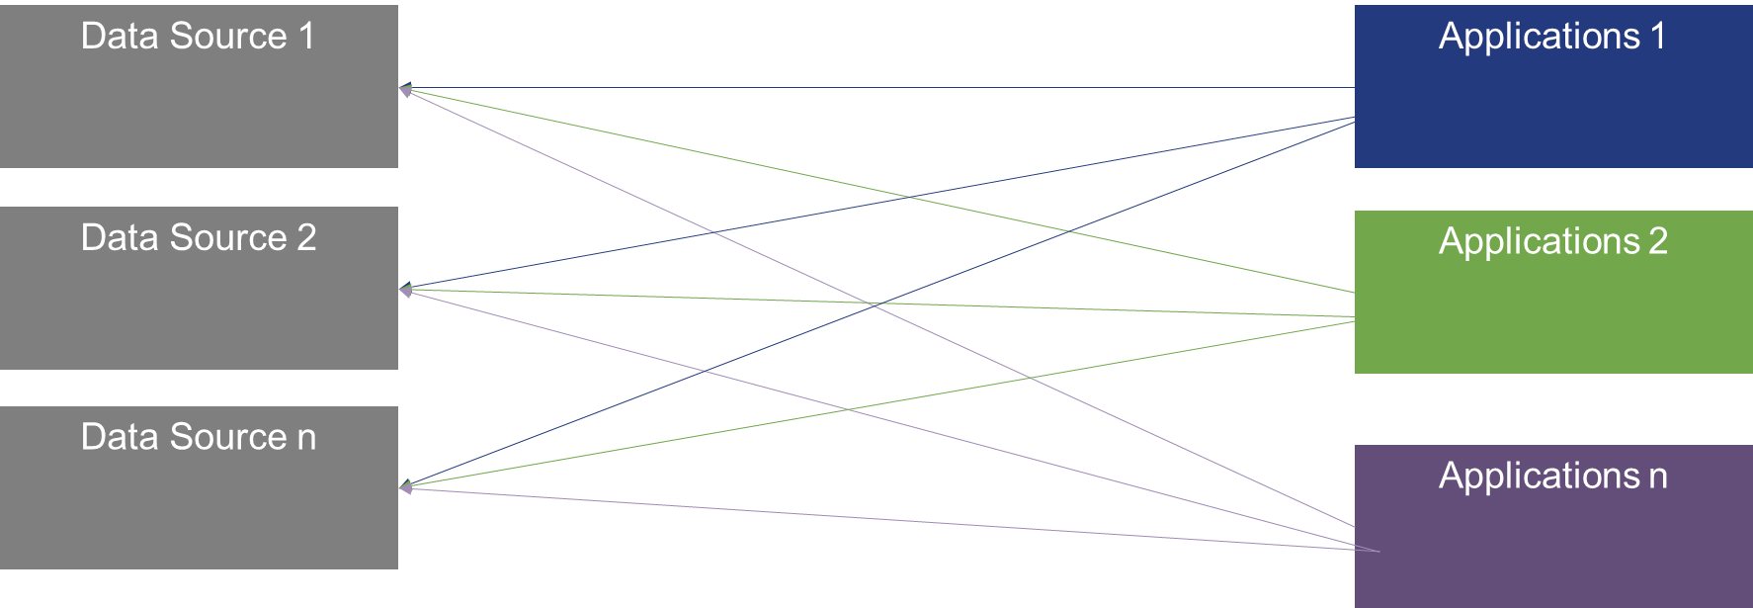
Application consuming without API Gateway or ESB
Overhead
Connectivity to Enterprise Applications
Each consuming apps to put the same effort to establish connectivity with Enterprise systems.
Number of connection increase as number of consuming apps increases
Application team need to cater to different security mechanism per Data Source.
Security Risk
Protecting sensitive data in transit
APIGEE provide features to perform message or field level encryption for sensitive data in transit
Without APIGEE, the data is flowing with only transport level security
Consolidated governance with APIGEE
Provides visibility in who is using the APIs and from where APIs are accessed
Approval based subscription to APIs
Rotating/Pre-defined expiry of API Key assigned to consumer app; on the fly change of API Key by Consumer app
Integration Risk
Abstraction – breaking up point-to-point brittle integrations and provide abstraction which ensures Consuming system impact on changes from source system are minimal.
Traffic Management with APIGEE
Control or Throttle the traffic to individual APIs thus safeguarding underlying Enterprise application from potential DDoS attacks
Reuse
Promotes reuses of services or orchestration of data

Slide 13
Network level Security

Slide 14
Cloud Setup- Network Security
API Consumer on Cloud
Enterprise Resources
API Gateway On Cloud
External Firewall
External Load Balancer
Apache Reverse Proxy
Internal Load Balancer

Slide 15
Hybrid Setup – Network Security

Slide 16
Data Access via API in Multi-cloud
Data access considerations
Hybrid API Management
(Message, User and Transport Level security)
Data residency: Refers to where the organization chooses to store their data (usually for regulatory or policy reasons).
Data sovereignty: Refers to a government’s rights of access to data found within its borders. These may differ widely from country to country and may extend beyond a country’s borders based on where the organization resides.
Data localization: Requires that data created within certain borders stay within them, or a copy of the data is kept within the country.
+
OPA (Open Policy Agent)
*Optional for more granular controls
=
Customizable Data access control ,enforced at user-level or client-levels

Slide 17
Apps, developers , Marketplace security

